Slide 1

Selective Cookie Outsourcing using Private Information Retrieval
Students: Apoorva Karnwal (22BCE0756),
Shivesh Kaushik (22BCE2232)
Guide: Prof. Kathiravan Srinivasan, Professor Grade 1
School: SCOPE, VIT
Programme: B.Tech. in Computer Science & Engineering
Date: September 2025

Slide 2
Abstract
Http Cookies or Browser cookies enable authentication, personalization, and analytics but also create privacy risks through tracking and profiling.
Current compliance mechanisms (cookie banners, CMPs) provide legal consent management but fail to ensure strong privacy protection.
ML models (XGBoost, LightGBM, CatBoost) classify cookies into essential, functional, analytics, and marketing.
Sensitive cookies are selectively outsourced using PIR with homomorphic encryption for secure retrieval.
A browser extension is developed as the client agent to monitor cookies, run classification, and apply selective PIR-based storage.
The framework ensures a scalable, deployable solution that balances privacy, usability, and performance.

Slide 3
Introduction
Background
HTTP Cookies: Small data-value pairs stored in browsers to maintain state in a stateless web.
Functions:
Session management (login, carts),
Personalization (preferences, themes),
Analytics & targeted advertising.
Key Attributes:
Domain & Path: Scope of cookie.
Secure: Sent only over HTTPS.
HttpOnly: Not accessible via JavaScript.
SameSite: Controls cross-site access (Strict, Lax, None).
Expiry: Session or persistent cookies.

Slide 4
Introduction (Cont.)
Background
Private Information Retrieval (PIR)
Concept: Allows users to retrieve data from a database without revealing which data was accessed.
How it Works: Uses cryptography (e.g., homomorphic encryption).
Prevents servers from learning user access patterns.
Types:
Computational PIR (CPIR): Single-server, relies on encryption.
Information-Theoretic PIR (ITPIR): Multi-server, stronger privacy guarantees.
Motivation
Traditional compliance mechanisms like banners and CMPs only provide legal consent management, but fail to protect users from tracking and profiling. Our project addresses this gap by developing a hybrid framework that combines ML-based cookie classification with selective PIR storage to ensure privacy without sacrificing usability or performance.

Slide 5
Literature Review & Research Gaps
Literature Review
Consent Banners & CMPs are often use dark patterns, and fail to enforce user choices.
Cookie Classification using ML (CookieMonster, CookieGraph) shows high accuracy with lexical, contextual, and behavioural features.
First-Party Tracking is increasing as trackers evade third-party restrictions.
Private Information Retrieval (PIR) has recent advances (e.g., Spiral PIR) reducing latency and improving practicality.
Research Gaps
Consent mechanisms (CMPs, banners) are compliance-focused, not privacy-focused.
Websites often continue to set non-essential cookies even after rejection.
ML-based classification is effective at detection but does not enforce privacy.
PIR protocols provide strong privacy but are rarely applied in cookie management.
Gap: No integrated solution combining ML classification with selective PIR for scalable, privacy-preserving cookie management.

Slide 6
Project Plan
Cookie Data Collection
Web scraping and labelled cookie collection from CMPs.
Data cleaning, preprocessing, and feature extraction.
Cookie Classification using ML
Train models (CatBoost, LightGBM, XGBoost) to classify cookies into the categories: Essential / Functional / Analytical / Marketing.
Validate and test classification performance (accuracy, F1-score).
PIR Implementation
Implement PIR protocols (CPIR & ITPIR).
Test secure storage and retrieval of sensitive cookies.
System Integration
Integrate ML classification with PIR module.
Deploy and test in a browser extension environment.

Slide 7
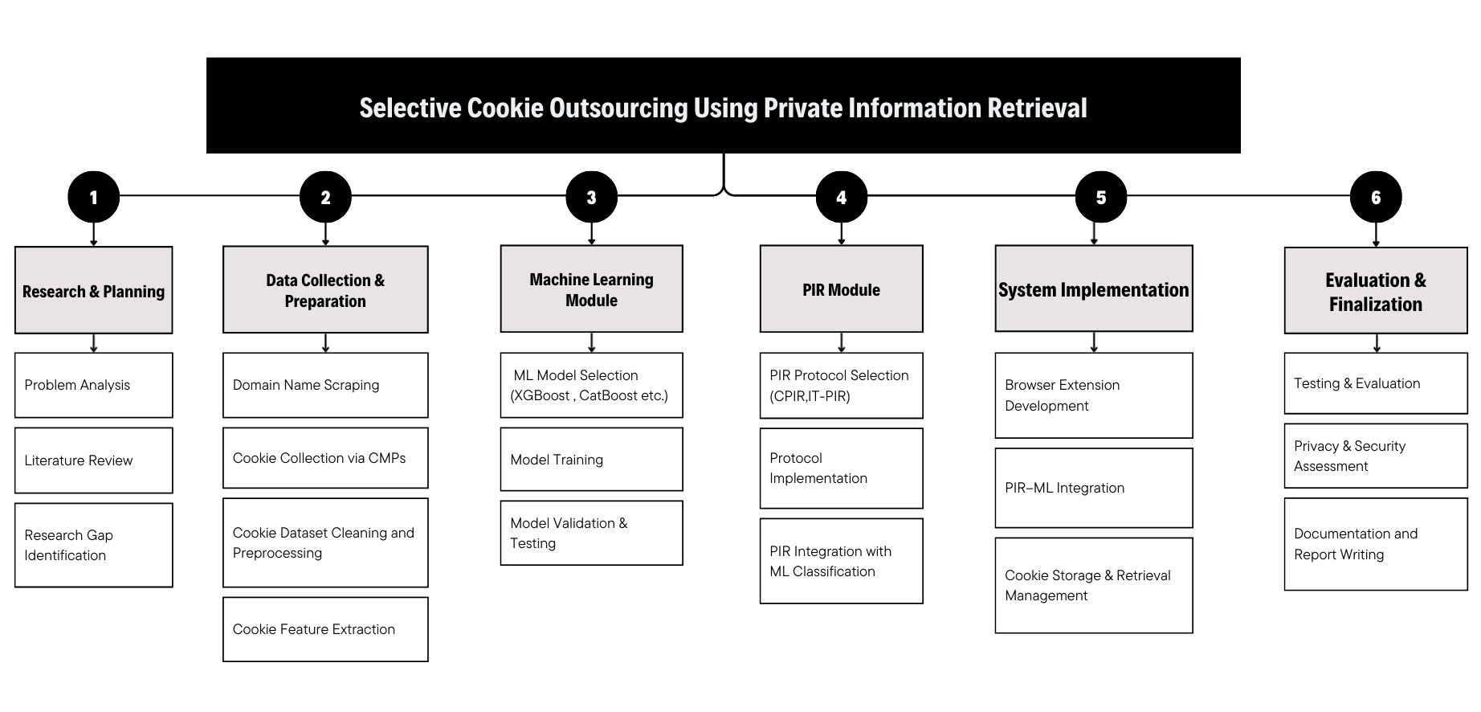
Work Breakdown Structure
Figure 1: WBS – Work Breakdown Structure

Slide 8
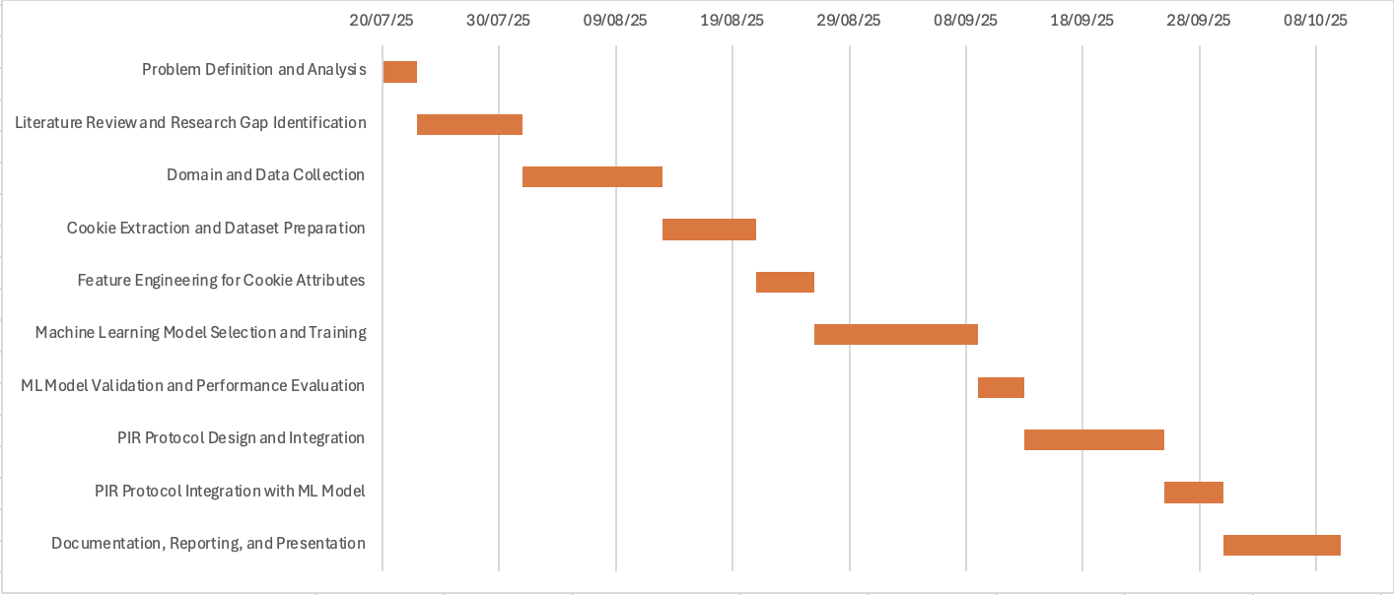
Gantt Chart
Figure 2: Gantt Chart

Slide 9
Requirement Analysis
Functional Requirements
Collect and preprocess cookies from websites.
Classify cookies using ML models (XGBoost, LightGBM, CatBoost).
Store sensitive cookies securely with PIR.
Non-Functional Requirements
Low latency and high scalability.
Reliable handling of dynamic websites.
Seamless user browsing experience.
Tools & Software
Python, OpenWPM, Selenium (Firefox + geckodriver) for dynamic crawling.
scikit-learn / XGBoost / LightGBM / CatBoost for ML.
Cryptography libraries (for PIR / homomorphic encryption).
Docker, Git/GitHub for reproducible setup & version control

Slide 10
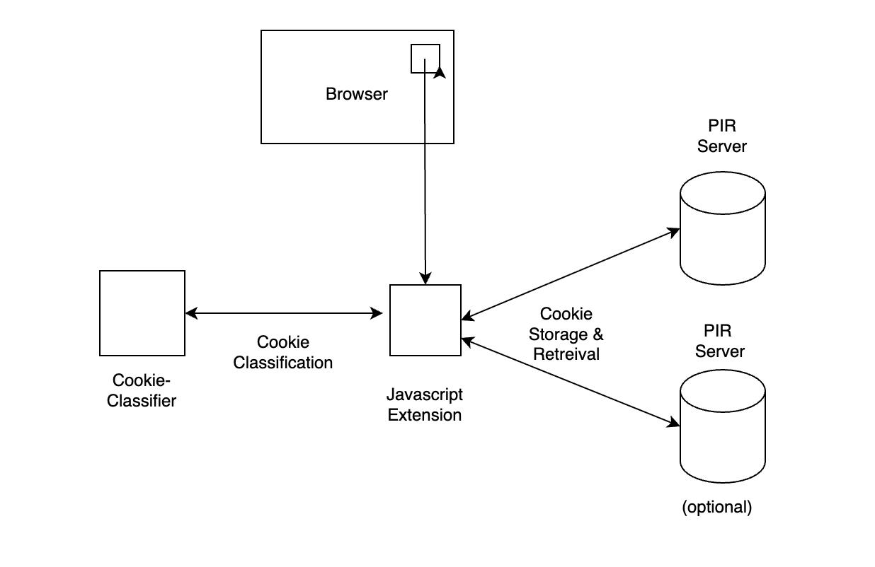
System Design
Figure 3: System Design

Slide 11
Conclusion
Proposed a hybrid framework combining ML classification with PIR for cookie privacy.
Enables accurate identification of privacy-sensitive cookies.
Selective PIR ensures strong privacy with reduced overhead.
Maintains usability, efficiency, and scalability for real-world deployment.
Provides a promising solution for privacy-conscious browsers and platforms.

Slide 12
References
[1] Berens, B. M., Bohlender, M., Dietmann, H., Krisam, C., Kulyk, O., & Volkamer, M. (2024). Cookie disclaimers: Dark patterns and lack of transparency. Computers & Security, 135, 103507.
[2] Kosztyán, Z. T., Király, T., Csizmadia, T., Katona, A. I., & Vathy-Fogarassy, Á. (2025). Automated research methodology classification using machine learning. Engineering Applications of Artificial Intelligence, 132, 107007.
[3] Hu, X., Sastry, N., & Mondal, M. (2021). Corralling cookies into categories with CookieMonster. In Proceedings of the ACM Web Science Conference (WebSci ’21) (pp. 56–65). ACM.
[4] U., Englehardt, S., Shafi, Z., & Troncoso, C. (2023). Understanding and detecting first-party tracking cookies. ACM SIGSAC Conference on Computer & Communications Security.
[5] Bouhoula, A., Kubicek, K., Zac, A., Cotrini, C., & Basin, D. (2023). Automated large-scale analysis of cookie notice compliance. In 32nd USENIX Security Symposium (USENIX Security 23) (pp. 4069–4086). USENIX Association.
[6] Bollinger, D., Kubicek, K., Cotrini, C., & Basin, D. (2022, August). Automating cookie consent and GDPR violation detection. In 31st USENIX Security Symposium (USENIX Security 22).
[7] Sivan-Sevilla, I., Parham, P., & McGuigan, L. (2025). ‘Cookie-less’ identification for/against privacy? Internet Policy Review, 14(3).
[8] Luo, M., & Wang, M. (2025). Faster Spiral: Low-communication, high-rate private information retrieval. Cryptography, 9(1), 13

